Slide 1



Unit - 3
Machine Learning

Slide 2
Chapters for Discussion
Chapter - 1
Introduction – Machine Learning – Supervised, Unsupervised ML
Chapter - 2
Linear Machine learning model
Chapter - 3
Non-Linear Model

Slide 3

Chapter 3
Non-Linear Model

Slide 4


DISCLAIMER
The content is curated from online/offline resources and used for educational purpose only.

Slide 5

Learning Objectives
Classification
Understand and build Support Vector Machine
Understanding the key components of SVM.
Learning Margins, Feature space and decision boundary.
GOAL

Slide 6
Introduction to Support Vector Machine
A Support Vector Machine is a supervised algorithm that can classify cases by finding a separator.
SVM works by first, mapping data to a high-dimensional feature space so that data points can be categorized, even when the data are not otherwise linearly separable.
Then, a separator is estimated for the data.
The data should be transformed in such a way that a separator could be drawn as a hyperplane.

Slide 7
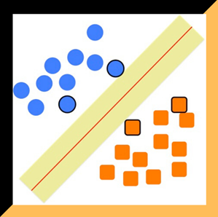
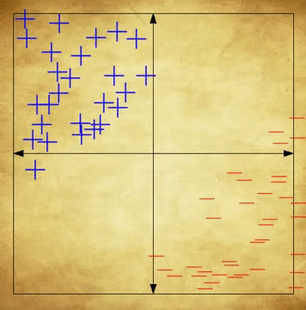
Support Vector Machine (SVM)

Slide 8
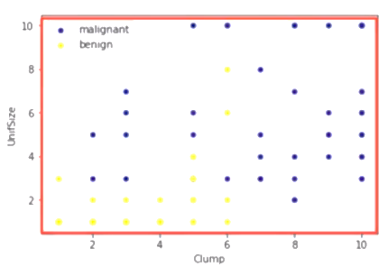
Feature Space
For example, consider the following figure, which shows the distribution of a small set of cells, only based on their Unit Size and Clump thickness.
It represents a linearly, non-separable, dataset.

Slide 9
Decision Boundary
The two categories can be separated with a curve.
Not a line that formulates most real-world datasets.
Twist and Turns on trajectory

Slide 10
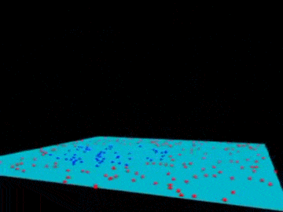
Dimension Expansion
We can transfer this data to a higher dimensional space.
For example, mapping it to a 3-dimensional space.
Separation boundary gets simplified
Reference

Slide 11
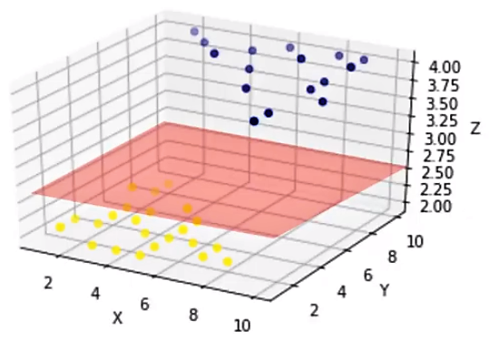
Hyperplane
After the transformation, the boundary between the two categories can be defined by a hyperplane.
As we are now in 3-dimensional space, the separator is shown as a plane.
This plane can be used to classify new or unknown cases.
Reference

Slide 12
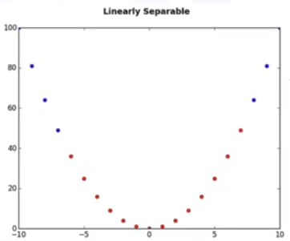
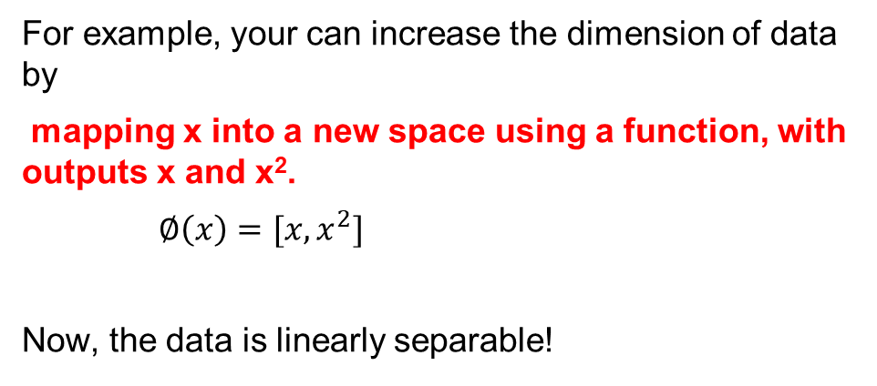
Transformation Approach
For example, your can increase the dimension of data by
mapping x into a new space using a function, with outputs x and x².
$∅\left(x\right)=[x,x^{2}]$
Now, the data is linearly separable!

Slide 13
Transformation Approach
Notice that, as we are in a two-dimensional space, the hyperplane is a line dividing a plane into two parts where each class lays on either side.
Now we can use this line to classify new cases.
Reference

Slide 14
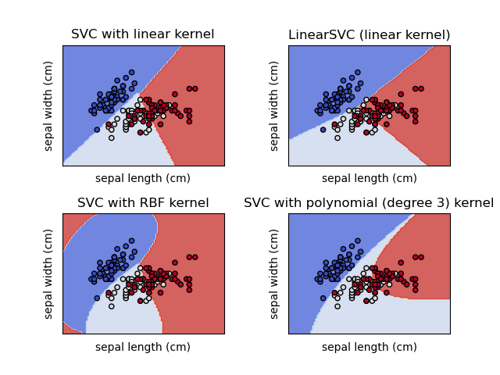
Kernel in Support Vector Machine
Mapping data into a higher dimensional space is called kernelling.
The mathematical function used for the transformation is known as the kernel function, and can be of different types, such as:
Linear,
Polynomial,
Radial basis function (or RBF), and
Sigmoid.
Already implemented in form of machine learning libraries.
Choose different functions in turn and compare the results.
Reference

Slide 15
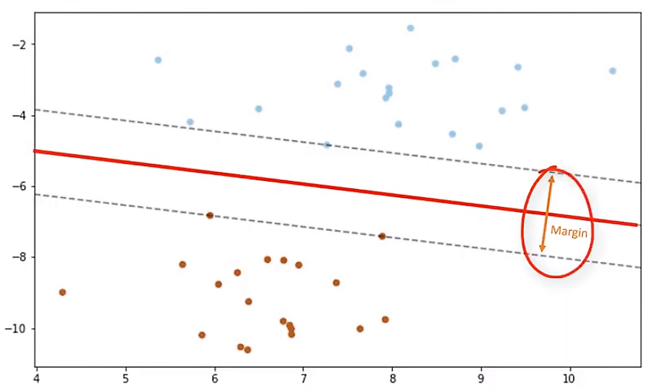
Finding Optimized Separator after Transformation
One reasonable choice as the best hyperplane is the one that represents the largest separation, or margin, between the two classes.
So, the goal is to choose a hyperplane with as big a margin as possible.

Slide 16
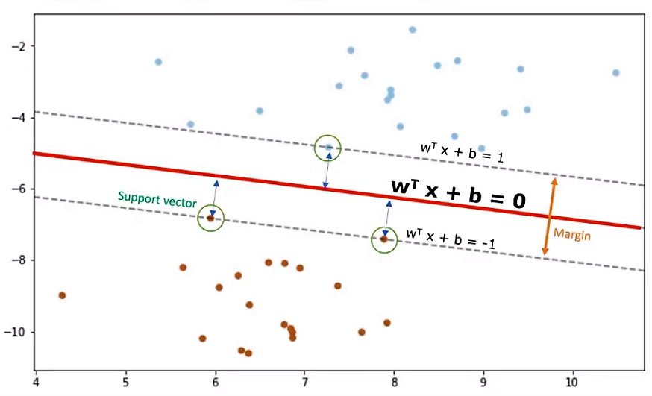
Margins
Only support vectors matter for achieving our goal; and thus, other training examples can be ignored.
We try to find the hyperplane in such a way that it has the maximum distance to support vectors, called optimal Hyperplane.
Hyperplane is learned from training data using an optimization procedure that maximizes the margin.
This optimization problem can be solved by Gradient descent.
Reference

Slide 17
SVM Outcomes
The output of the algorithm is the values ‘w’ and ‘b’ for the line.
You can make classifications using this estimated line.
It is enough to plug in input values into the line equation, then, you can calculate whether an unknown point is above or below the line.
If the equation returns a value greater than 0, then the point belongs to the first class, which is above the line, and vice versa.

Slide 18

Lab Activity
Hands On
Lab 1
Demonstrating Support Vector Machine

Slide 19

Conclusion
Regression
It is a statistical method to understand the relationship between a dependent variable and one or more independent variables.
Linear regression models relationship as a straight line, aiming to minimize the error between predicted and actual values.
Model complexity increases with more features, leading to overfitting, which reduces model performance on new data.
Regularization (Lasso, Ridge) penalizes complex models to prevent overfitting and improve generalization.
Logistic regression handles binary outcomes using a sigmoid function to map predictions to probabilities.
Classification
Decision trees are used for both classification and regression, but excel at classification by creating a tree-like model based on information gain.
Entropy measures data randomness, while information gain quantifies the reduction in randomness after splitting data.

Slide 20
Reference
https://scikit-learn.org/stable/modules/generated/sklearn.linear_model.LogisticRegression.html
https://www.r-bloggers.com/2020/09/logistic-regression-in-r/
"Introduction to Logistic Regression Analysis" by William J. Rudasill, Richard G. Lomax, and
https://kawsar34.medium.com/machine-learning-quiz-05-decision-tree-part-1-3ea71fa312e5
https://www.javatpoint.comwww.towardsdatascience.com
https://www.coursera.org/learn/machine-learning
https://scikit-learn.org/stable/modules/linear_model.html#ordinary-least-squares
Kriegel, Hans-Peter; Schubert, Erich; Zimek, Arthur (2016). "The (black) art of runtime evaluation: Are we comparing algorithms or implementations?". Knowledge and Information Systems. 52 (2): 341–378. doi:10.1007/s10115-016-1004-2. ISSN 0219-1377. S2CID 40772241.
MacQueen, J. B. (1967). Some Methods for classification and Analysis of Multivariate Observations. Proceedings of 5th Berkeley Symposium on Mathematical Statistics and Probability. Vol. 1. University of California Press. pp. 281–297. MR 0214227. Zbl 0214.46201. Retrieved 2009-04-07.
Steinhaus, Hugo (1957). "Sur la division des corps matériels en parties". Bull. Acad. Polon. Sci. (in French). 4 (12): 801–804. MR 0090073. Zbl 0079.16403.
Notes:
Dear students Here are the references used to create the material for the study purpose only
Good bye everyone have a nice day.
20

Slide 21
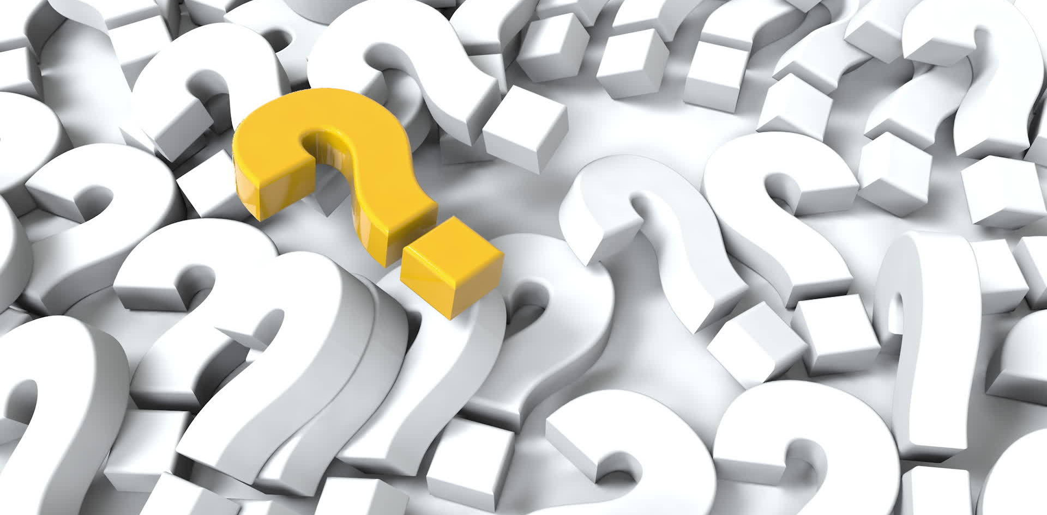

Let’s Start

Slide 22


Quiz
Which of the following statements is not true about SVM?
It is memory efficient
It can address a large number of predictor variables
It is versatile
It doesn’t require feature scaling
Answer: D
It doesn’t require feature scaling

Slide 23
Quiz
2. What do you mean by generalization error in terms of the SVM?
How far the hyperplane is from the support vectors
How accurately the SVM can predict outcomes for unseen data
The threshold amount of error in an SVM
To maximize the p-value of the regression coefficients
Answer: B
How accurately the SVM can predict outcomes for unseen data

Slide 24
Quiz
3. The minimum time complexity for training an SVM is O(n2). According to this fact, what sizes of datasets are not best suited for SVMs?
Large datasets
Small datasets
Medium-sized datasets
Size does not matter
Answer: A
Large datasets

Slide 25
Thank You
Notes:
Thank You !!

